Slide 1

Breast Cancer Detection

Slide 2


KADI SARVA VISHWAVIDYALAYA
LDRP INSTITUTE OF TECHNOLOGY AND RESEARCH
GANDHINAGAR
PROJECT PROPOSAL
GROUP -53
GUIDED BY:-
Dr. Mehul P. Barot
Department of Computer Engineering
Team Members:
Keyur Chaniyara 19BECE30095
Jaivin Gajera 19BECE30075
Prachi Jethava 19BECE30140
Yatree Ladani 19BECE30220

Slide 3
PROBLEM STATEMENT
Currently, breast cancer is the second leading cause of death for women worldwide. Although more women today are being diagnosed with breast cancer than in past years. Thus to reduce time and to detect the cancer Deep learning and Machine learning models are required.

Slide 4
ABSTRACT
The aim of this study was to evaluate the diagnostic accuracy of multipurpose image analysis software based on deep learning with InceptionV3 for the detection of breast cancer in an independent, mammography data set. A neural network is trained to detect the spot, based on Threshold. The system also perform image enhancement and image segmentation of the mammogram images and detect the spot of the cancer. And the list of questions are asked to know the risk of the cancer occur in future and to know the reason behind the cancer. Waiting for diagnosing a breast cancer for a long time may increase the possibility of the cancer spreading. Therefore a computerized breast cancer diagnosis has been developed to reduce the time taken to diagnose the breast cancer and eventually reduce the death rate.

Slide 5
Table of Contents
01
02
03
04
Objectives
Architecture
Results Analysis
Conclusion

Slide 6
01
OBJECTIVES

Slide 7
OBJECTIVES
Filter the image and enhance the quality
Predict the cancer
Aware you about a future risk of a cancer

Slide 8
02
ARCHITECTURE

Slide 9
Architecture Design
Image Processing
Question Analysis
In image processing mammogram images are enhanced using different types of filter.
Questions will help to know the future risk of breast cancer and also tells some reason for detected cancer.
Data Collection
Inseption V3 Model
This model is used for classification of mammogram images in normal and abnormal categories
N
A

Slide 10
Algorithm
Inception-v3 is a pre-trained convolutional neural network model that is 48 layers deep. The network has an image input size of 299-by-299. The model extracts general features from input images in the first part and classifies them based on those features in the second part

Slide 11
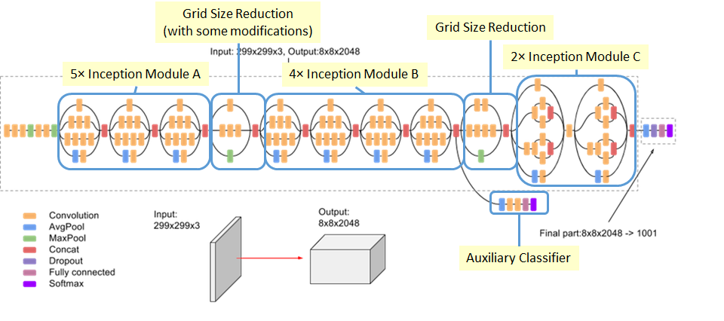
INCEPTION-V3 MODEL

Slide 12
Mathematical Model
Let image matrix b X
Z= X * f (where f is a filter matrix)
Z= W*X + b (where W is weight matrix and b is bias matrix)

Slide 13

TECHNOLOGIES USED
FRONT END
HTML , CSS, JS , BOOTSTRAP
BACKEND
DL Algorithms, Flask, Transform learning methods, Image processing method , Python, Matplotlib, NumPy, Pandas, Seaborne, OpenCV, Sklearn, Tensorflow

Slide 14
03
RESULT ANALYSIS

Slide 15
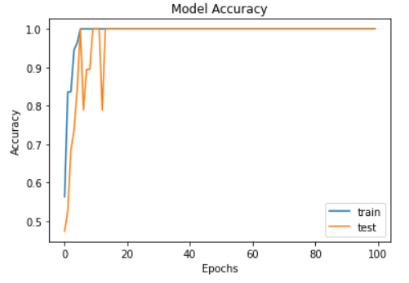
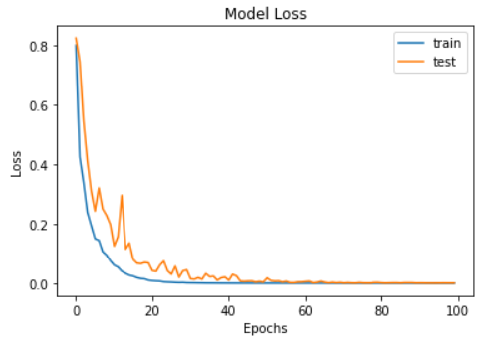
ACCURACY AND LOSS

Slide 16
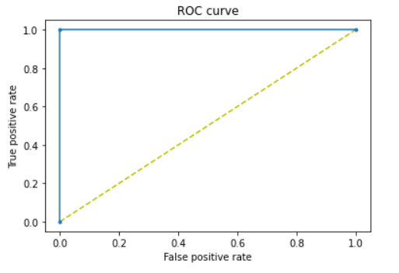
ROC CURVE

Slide 17
Phase 1
20 Patients
100%
12 Normal
08 Abnormal
Model Success Ratio
Results
All images classified successfully.
Cancer spot detected successfully.

Slide 18
Trial Timeline
01
02
03
04
05
Research & Analysis
Deep learning model
Conclusion
Dataset collection & Requirement gathering
Results

Slide 19
FUTURE SCOPE
Future scope can be the categorized case into beginning and malignant stage.
To merge image processing and prediction part at same platform.
Try to enhance our model with more test and training cases.

Slide 20
04
CONCLUSION

Slide 21

Conclusions
In our project BCD system takes the mammogram to detect a cancer with less time which helps doctors and patient to diagnose and detect breast cancer at a beginning stage and to get proper treatment within a safe time, which will help them to recover quickly after diagnosis.

Slide 22
Thanks!

